Slide 1


IT Project Management Chapter 1: Project Life Cycle

Slide 2
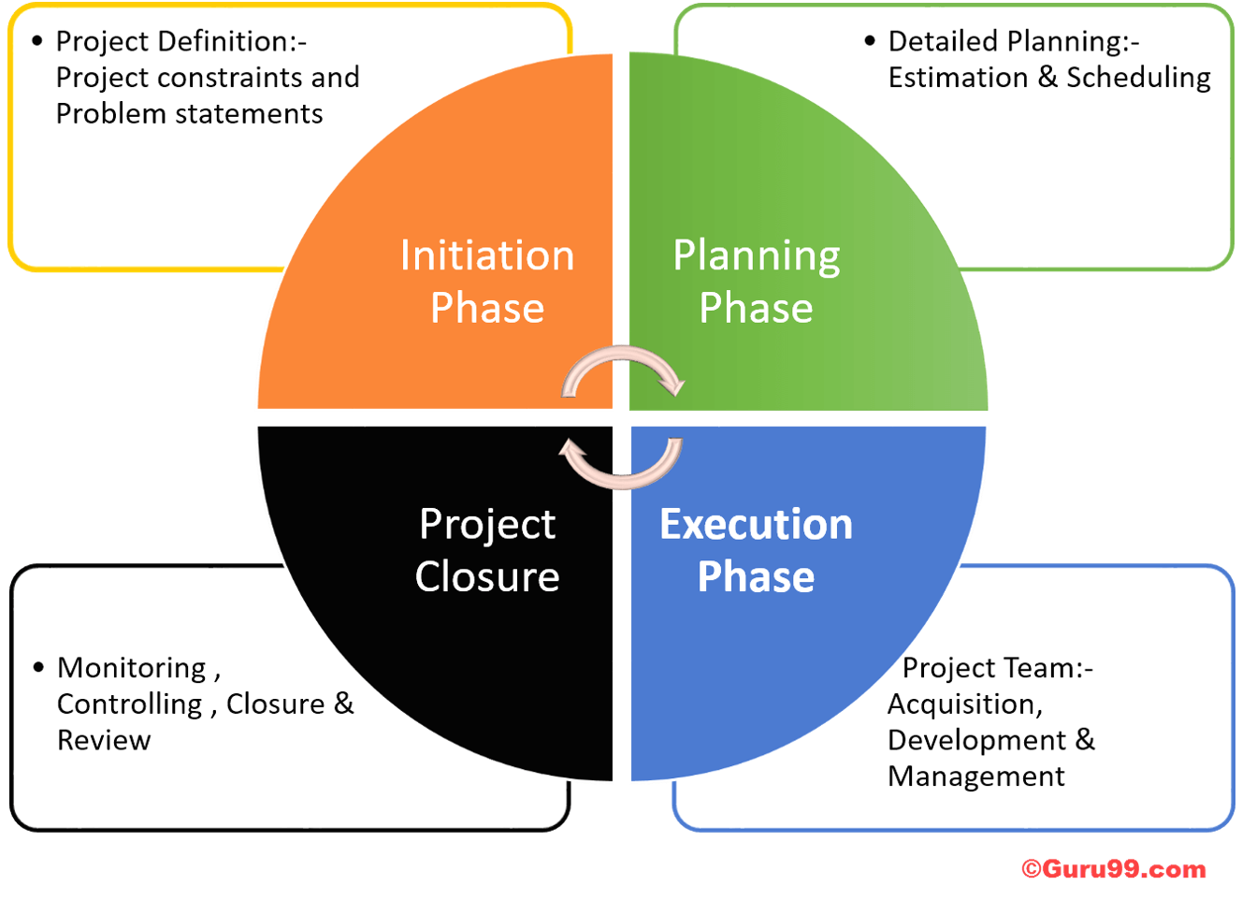
Overview
What is a project life cycle
Budget request vs project request
Project periods

Slide 3
Project Management Life Cycle
Project Proposal
Project Delivery Process
Initiate
Plan
Execute
Close
Project Charter
High level scoping
Stakeholders
Project kickoff
Project plan
Collab site created
Requirement Specifications
Communication Plan
Resources
Assessment
Design specifications
Deployment plan
Test plan
Training plan
Production Readiness
Support plan
Lessons learned
Assessment
Closure report
Monitor and Control
Meeting notes, Status reports, Change control, Risk management, Issue log
Deliver
Routine maintenance and support

Slide 4
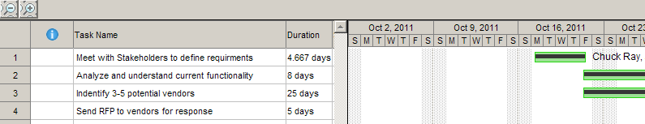
Benefits of the PM Life Cycle?
Standardized process
Scaled from the PMBOK
Provides a framework for how projects are managed
Flexibility – not all projects are the same

Slide 5
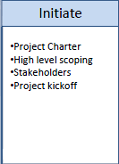
PM Life Cycle - Initiate
Project is submitted, reviewed and is now active
Stakeholders have been identified
Business case the for the project (Project Charter) has been documented at a high level
Kickoff meeting with all stakeholders

Slide 6
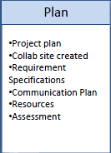
PM Life Cycle - Plan
ITS resources are allocated
Functional requirements are documented
Technical requirements are documented
Project plan is created (first iteration)
Potential vendors are identified

Slide 7
PM Life Cycle – Plan cont’d
Requirements are sent to vendors for response
Three top vendors identified
Product demonstrations are held
Three cost analysis including vendor comparison and STEP considerations (typically security, web & interface concerns are documented
Product recommendation is presented by the project team.

Slide 8
PM Life Cycle – Plan (cont’d)
The planning stage is iterative throughout the project life cycle
Planning is one of the most important phases of the project cycle

Slide 9
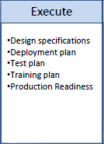
Project Life Cycle - Execute
Contracts are executed and purchasing occurs
Implementation begins
Technical components are installed and configured
Business processes are implemented / re-engineered
Unit testing performed (Technical Teams)
Integrated testing performed (Business Departments)
Test failures are documented, corrected and retested.

Slide 10
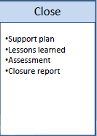
Project Life Cycle - Close
User acceptance and sign off
Project is deployed to production
Support is turned over to appropriate group
All final documentation is uploaded to Collab
Lessons learned are documented
Project is marked completed

Slide 11
Allocation of time and money…….
10%
Initiation
20%
Initiation
Planning
Planning
25%
30%
Implementation
Implementation
60%
40%
5%
Closing
10%
Closing
Typical
Successful projects
Notes:
Typically – where project management isn’t done very well, the split will be about one third in the first 2 phases and two thirds in the second two phases
A good project will be split about 50-50 – where more emphasis is put on good project definition and planning
………and actually the whole thing will take longer in a poorly managed project

Slide 12
PM Life Cycle – Monitor & Control
Runs across each stage of the life cycle
Regular project meetings
Changes to project scope are analyzed, documented and prioritized
Review project timeline
Project risks are documented and a mitigation strategy is documented.
Issue log is reviewed and updated

Slide 13
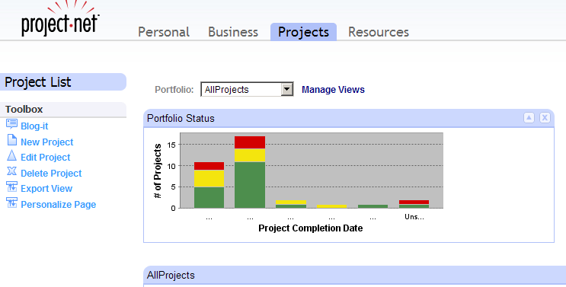
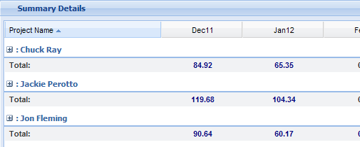
PM Tools
Project.Net
Portfolio Mgmt
Resource Allocation
Overall project status
Time Keeping

Slide 14
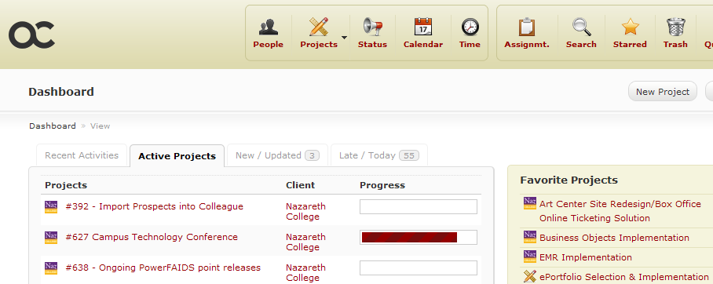
PM Tools
ActiveCollab
Document Respository
Milestones
Project team
Collaboration

Slide 15
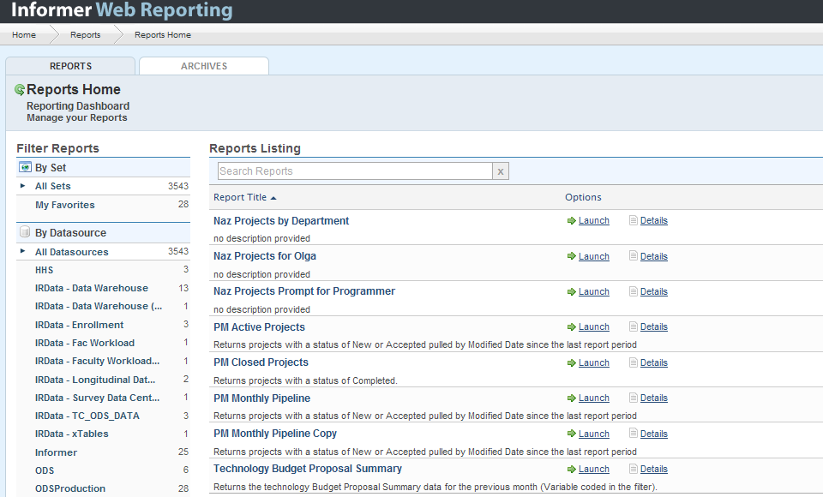
PM Tools
Monthly project review
Monthly project reports including the project pipeline, active projects and closed projects

Slide 16
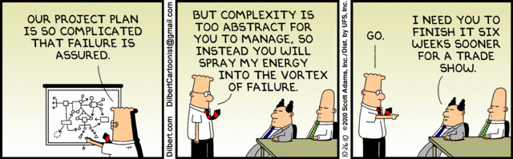
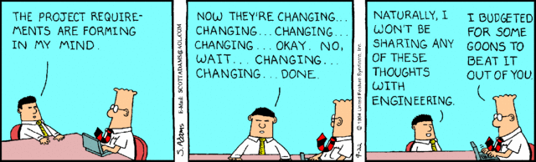
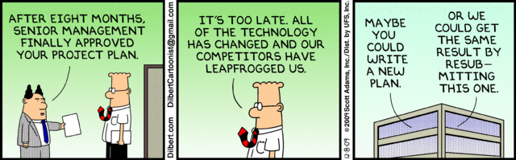
Fun with Dilbert

Slide 17

Thank you!

